Slide 1
Immigration Detention: women's health & wellbeing
Maria Hach, Adele Murdolo & Jasmin Chen
Multicultural Centre for Women’s Health (MCWH)

Slide 2
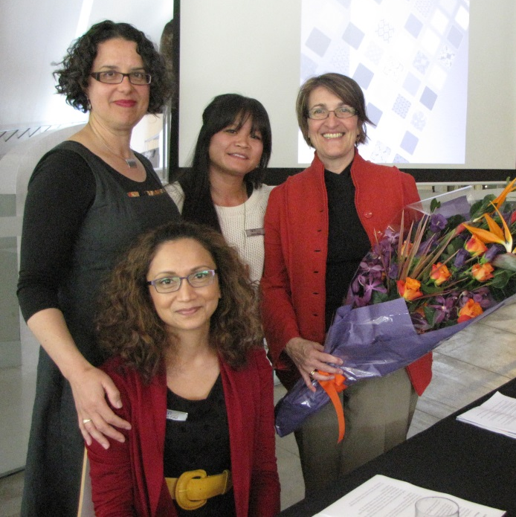
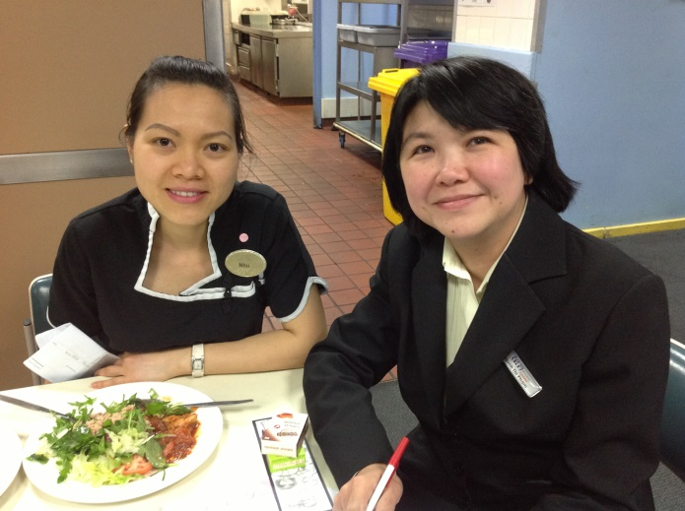
Who are we?
Who we are
A national voice for immigrant and refugee women’s
health and wellbeing
Notes:
The Multicultural Centre for Women’s Health (MCWH) is a national women’s health organisation which is committed to improving the health and wellbeing of immigrant and refugee women around Australia.
MCWH is the national voice for all women from immigrant communities, including refugee and asylum seekers, international students and women from both emerging and established communities.

Slide 3
Who are we?
What do we do?
Research & Advocacy
Health Education
Multilingual Library
Training
Notes:
What do we do?
MCWH looks for innovative ways to improve the health and wellbeing of women from migrant and refugee backgrounds by:
Building the health literacy of migrant and refugee women, through advocacy, social action, multilingual education, research and capacity building, and
Improving the cultural literacy of health service providers to better address the specific needs of clients from diverse cultural backgrounds
We deliver expert multilingual education through Industry Visit (IVP) and Community Workshop Programs (CWP) with a diverse range of migrant and refugee women from many backgrounds.
We also provide professional training, consultation and support for bilingual community workers across Australia and for health and community organisations working with migrants and refugees. This includes providing education resources and manuals on request.
MCWH has a comprehensive multilingual library and resource collection which covers health topics for women in many languages. Contact us for health information and we can send you related resources.

Slide 4
Australian immigration detention
Mandatory detention policy since 1992
Proliferation and privatisation of facilities
Main provider: Serco Australia ($1.77 bill)
Health service provider: IHMS ($679.81 mill)
Notes:
Mandatory Detention: ALP initiative, bipartisan support
From a handful of centres in the early 1990s, to 19 now.
July 2013 policy – anyone who arrives undocumented by sea (IMA) will not be considered for permanent settlement in Australia, regardless of the outcome of the person’s asylum claim
Serco: five year contract 2009-2014 – took over from G4S
Serco is a British company – whose operations include transport, traffic control, weapons (including nuclear), detention centres, prisons and SCHOOLS!
Also runs Yarls Wood in England –in 2013, sexual abuse cover-ups were investigated.
International Health and Medical Services (IHMS) also on a 5 year contract until 2014

Slide 5
Immigration detention facilities
19 Australian facilities
4 types – based on ‘risk’ and ‘security’ need
1. immigration detention centres (IDC)
2. immigration residential housing (IRH)
3. immigration transit accommodation (ITA)
4. alternative places of detention (APOD)
Notes:
16 in Australia across every state and territory except Tasmania, but including Christmas Island, and 3 off-shore in Nauru and PNG

Slide 6
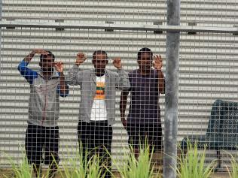
Immigration detention facilities
Immigration detention centres (IDC)
‘medium and high risk detainees’
the majority of the population are single adult men.

Slide 7
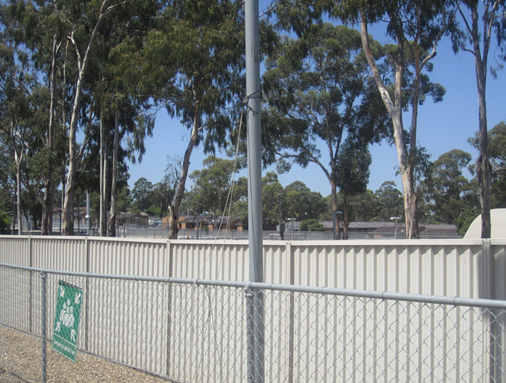
Immigration detention facilities
Immigration residential housing (IRH) & transit accommodation (ITA)
Flexible, some hostel style, housing with more autonomy
“able to cook their own food, go shopping & take part in community events”
Notes:
The image is titled “View from inside Sydney IRH (looking out to Villawood IDC) so every day they get to remember how it could be worse.

Slide 8
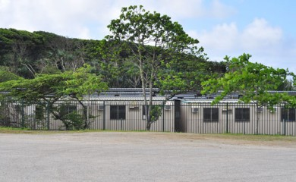
Immigration detention facilities
Alternative places of detention (APOD)
For those who are considered “minimal risk to our communities”
often used to accommodate families, children and people in need of medical treatment

Slide 9
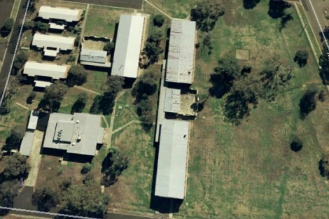
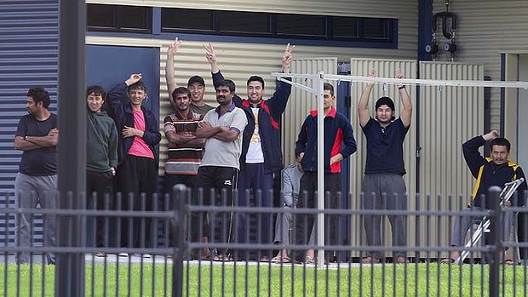
Common factors
Deprivation of liberty
Restrictions to movement
Punishment
Increased risk of violence
Uncertain future
Notes:
Image aerial view is Melbourne ITA
Image with men is Brisbane ITA

Slide 10
Who is in immigration detention?
As of the 31st August 2014
5,757 people
2,482 on the mainland
958 on Christmas Island
2,317 offshore (Nauru & PNG)
Notes:
A further 3038 people were living in the community after being approved for a residence determination and 24702 were living in the community after grant of a Bridging Visa E.
What does it mean to be in residence determination?
“Asylum seekers released into community detention on a residence determination still have some restrictions on their movement and are not permitted to work. However, community detention mitigates many of the negative impacts of detention in a closed facility by allowing detainees to have a degree of independence and making it easier for detainees to access services and community support.”
What does it mean to be in the community after grant of a Bridging Visa E?
“Asylum seekers released on bridging visas are not provided with public housing, do not have access to financial support from Centrelink and must report to the Department of Immigration on a regular basis. Those who arrived in Australia before 13 August 2012 are eligible to work but those who arrived after this date are not. Asylum seekers who are unable to find work or are not eligible to work receive basic income support paid at 89% of the Centrelink Special Benefit.”
(Info from refugee council)

Slide 11
Who is in immigration detention?
As of the 31st August 2014
In addition
3,038 on ‘residence determination’
24,702 on Bridging Visa E
Notes:
A further 3038 people were living in the community after being approved for a residence determination and 24702 were living in the community after grant of a Bridging Visa E.
What does it mean to be in residence determination?
“Asylum seekers released into community detention on a residence determination still have some restrictions on their movement and are not permitted to work. However, community detention mitigates many of the negative impacts of detention in a closed facility by allowing detainees to have a degree of independence and making it easier for detainees to access services and community support.”
What does it mean to be in the community after grant of a Bridging Visa E?
“Asylum seekers released on bridging visas are not provided with public housing, do not have access to financial support from Centrelink and must report to the Department of Immigration on a regular basis. Those who arrived in Australia before 13 August 2012 are eligible to work but those who arrived after this date are not. Asylum seekers who are unable to find work or are not eligible to work receive basic income support paid at 89% of the Centrelink Special Benefit.”
(Info from refugee council)

Slide 12
Women in detention

Slide 13
Notes:
Where are they from?
The chart here only shows the statistics for immigration detention facilities, but you can see that it isn’t just refugees from the middle east as is so often portrayed in the media.
Of 3440 people in detention, around 27.8% were from Iran, 16.8% were from Vietnam, 11.3% were Stateless, 7.6% were from Sri Lanka and 4.9% were from Afghanistan.
For the 3038 people who are living in the community after being approved for a residence determination, around 28.6% were from Iran, 23.3% were from Sri Lanka, 14.5% were Stateless and 10.5% were from Afghanistan.

Slide 14
Who is in immigration detention?
Notes:
They did not all arrive in the country undocumented. They are not all adults.
The number of people in immigration detention facilities, who arrived undocumented by air or boat as at 31 August 2014 was 2944, representing approximately 86% of the total immigration detention population.
There were also 496 people (about 14% of the total immigration population) who arrived in Australia lawfully and
were subsequently taken into immigration detention and had visa cancellations for either over staying or breaching their visa conditions.
As at 31 August 2014, there were 647 children (aged under 18 years) in Immigration Residential Housing,
Immigration Transit Accommodation and Alternative Places of Detention. The number of children in immigration facilities decreased in August due to children completing mandatory processing and being transferred into the community or to an Offshore Processing Centre as part of a family group.

Slide 15
Concepts
Global diffusion (Flynn)
Australian nationalism/National security
‘Crimmigration’
Scapegoating ‘illegal’ immigrants

Slide 16
Global diffusion
Before the 1980s, detention was an ad hoc tool used in crisis situations
It has became an entrenched policy apparatus to manage border control
exploited by private prison entrepreneurs.

Slide 17
“Crimmigration”
A growing convergence between criminal justice and migration control systems
Conflation of migration and criminality
Notes:
Crimmigration: a term used by mostly European scholars in relation to ID in Europe.
To manage migration, globally, there is an increased reliance on measures more commonly associated with criminal law enforcement for immigration law violations.
BUT it is important to point out that the process fails to ensure that there are necessary formal safeguards, as there are in the criminal justice system, eg. No possibility for a fair trial before incarceration.
In addition, immigration detention settings are not covered by the UN Rules on the Treatment of Women Prisoners and Non-Custodial Measures for Women Offenders (known as the Bangkok Rules), which recognise the distinct needs of women in the criminal justice system and introduce safeguards to protect women from gendered harms.

Slide 18
Australian nationalism
National security
‘terror threat’ is conflated with ‘cultural threat’
Fear of invasion by oppressive gender practices
Notes:
Nationalism and national security: Australia built on invasion and theft of land from Indigenous people, and at the same time, there is a collective forgetting of this fact. So the origins of Australian nation are replaced by myths and stories that represent white people as the owners of the land, and immigrants and refugees, particularly people of colour, are invaders of the land, threatening life, jobs, land and culture.
An extension of this representation is that non-Australian migrants are not as advanced as Australians, so that not only do they threaten change to culture, the change is not a progressive change, particularly when it comes to the way that women are treated. EG Muslim women have been objectified and demonised – because their culture is a threat. In this way, national security becomes less associated with physical harm and threat, and more associated with the need to contain cultural change.

Slide 19
Language
Illegal vs undocumented
Detainees vs people
Boat people
Irregular Maritime Arrival (IMA)
Notes:
Nationalism and national security: Australia built on invasion and theft of land from Indigenous people, and at the same time, there is a collective forgetting of this fact. So the origins of Australian nation are replaced by myths and stories that represent white people as the owners of the land, and immigrants and refugees, particularly people of colour, are invaders of the land, threatening life, jobs, land and culture.
An extension of this representation is that non-Australian migrants are not as advanced as Australians, so that not only do they threaten change to culture, the change is not a progressive change, particularly when it comes to the way that women are treated. EG Muslim women have been objectified and demonised – because their culture is a threat. In this way, national security becomes less associated with physical harm and threat, and more associated with the need to contain cultural change.

Slide 20
Health & wellbeing issues
Pregnancy-related risk
Poor access to facilities and services
Depression and mental health
Increased risk of gendered violence
Notes:
Caroline de Costa is Professor of Obstetrics and Gynaecology and Director of the Clinical School at James Cook University School of Medicine and has practised obstetrics for 20 years in regional Queensland. She has written a number of articles on pregnancy-related care in relation to asylum-seeking women in Darwin, and particularly in Nauru or Christmas island.
She has identified a number of challenges that pregnant asylum seeking women face, and criticised the conditions available to them. Although some of these challenges are related to the remote nature of the off-shore sites, others, like depression and lack of support, could apply to all women in detention settings.

Slide 21
Pregnancy & Birth
Delays accessing ante-natal care
No ante-natal care
Lack of information
Increased risk of adverse outcomes in birth
Notes:
Caroline de Costa is Professor of Obstetrics and Gynaecology and Director of the Clinical School at James Cook University School of Medicine and has practised obstetrics for 20 years in regional Queensland. She has written a number of articles on pregnancy-related care in relation to asylum-seeking women in Darwin, and particularly in Nauru or Christmas island.
She has identified a number of challenges that pregnant asylum seeking women face, and criticised the conditions available to them. Although some of these challenges are related to the remote nature of the off-shore sites, others, like depression and lack of support, could apply to all women in detention settings.
“There were frequent delays within the detention system in arranging antenatal care at RDH, and many women arrived in the hospital already in labour but without any details of their previous history or of any antenatal care. They were, however, accompanied by an impressive number of security officers — several independent observers have reported a guard for the woman, a guard for her partner and a guard for the baby, once born. While there is some suggestion that arrangements may now have improved in Darwin, it is noted that the number of pregnant women detained has dropped there and risen in Adelaide and Melbourne, where similar problems in communication continue and lead to difficulties in the provision of high-quality care.”
“Women were returned from Darwin to Christmas Island when the baby was 4 weeks old, and this practice is continuing at other hospitals. Mothers in Darwin had little help with lactation, and breastfeeding was not encouraged. In the “welcome” pack provided to new mothers by IHMS are feeding bottles and formula, although the facilities for adequate preparation and sterilisation of bottles were limited in the Darwin centres. These practices contravene World Health Organization and UNICEF recommendations, including the early initiation of breastfeeding within 1 hour of birth and exclusive breastfeeding for the first 6 months of life.”
Reference: Caroline M de Costa. ‘Antenatal care for asylum seeker women: is “good enough” good enough?’ Med J Aust 2014; 201 (5): 299-300

Slide 22
“ I don’t want to remember those horrible moments of my life which I spent in detention, when I cried for food and cried due to pain…I got weaker by the day. I lost 6 kg of my actual weight – it should increase in pregnancy”
— a pregnant woman detained in Yarl’s Wood

Slide 23
Mental Health
Depression and anxiety
Uncertain future – ‘no place to bring up a baby’
Increased risk of suicide
Notes:
Professor Elizabeth Elliott from the Sydney Medical School at the University of Sydney recently toured the Christmas Island facility as part of a National Inquiry into children living in detention in 2014.
“At the same time that Professor Elliott was on the island, there were ten women on continuous watch because they tried to hurt themselves. ''They were all women with young babies, and the reason that they had self-harmed is that they had been asking for better conditions for their babies. They said it was just intolerable to stay in these conditions any longer,” she said. “I think that's an indication of just the strength of the feelings of the mother that detentions centers are no place to have a young baby.””(Reported in VICE magazine August 6 2014)
In February 2014, a woman made the decision to terminate a pregnancy because she didn’t feel ot was appropriate to raise a child on Nauru.

Slide 24
“There is overwhelming evidence that detention has an independent, adverse effect on mental health, over and above any pre-existing illness or trauma. This is compounded when detention is offshore and in remote locations where there is little if no access to mental health and other services (including legal, medical and interpreting services), and where the ethical delivery of such services is seriously compromised.”
— The Australian Psychological Society
Notes:
But as de Costa notes, depression and a sense of hopelessness is far more dangerous to women’s health an mental well being. De Costa noted a high level of depression.
As she notes “The result for most asylum seekers is depression. Much has already been published about the mental health of male asylum seekers and the manifestations of depression, including self-harm. In the case of pregnant women, depression can have a direct and deleterious effect on the wellbeing of the fetus, through alterations in the production of the hormones needed for healthy pregnancy. There is a recognised association of antenatal depression with miscarriage, preterm labour and small-for-gestational-age babies. Antenatal depression is likely to merge into postnatal depression (PND). PND is also likely after the return of women to offshore detention. I personally saw women suffering PND in Darwin, and it has been reported on both Nauru and Christmas Island. Untreated PND can result in failure of the bonding and attachment between mother and child that is essential for healthy mental and physical development. The JAC reported that the Edinburgh Postnatal Depression Scale, which is validated for use in different cultural groups, is in use on Nauru and that most women are reaching scores of 24, when the cut-off score for significant depression is 10. However, no information can be obtained as to what treatment, if any, is being offered to these women.”
You would imagine that issues like the child’s statelessness can also cause enormous distress.
The Department of Immigration recently acknowledged the dire situation for women and babies on the island when it arranged the transfer of a woman to Brisbane for an abortion. “I cannot possibly let this baby live on Nauru,” the woman told media. She and her husband confirmed that in any other circumstances they would have welcomed the pregnancy.

Slide 25
Gendered violence
Increased risk of sexual assault and harassment for girls and women
Limitations to freedom of movement within detention facility
Notes:
In the US there have been 185 sexual abuse cases since 2007.
Also allegations in Australian centres about sexual violence against women and children
Policies in centres restrict women’s freedom of movement, rather than that of the perpetrator.

Slide 26
Imagining a different world
A world without detention
De-criminalisation of migrants
Women’s health at the centre
Notes:
Yesterday, Melissa Lukashenko imagined a world where Aboriginal people
We have lived in a world without detention
Connecting this the prison abolition movement, and maybe how people here can think about the parallels between immigration detention and prison, and women’s experiences.

Slide 27
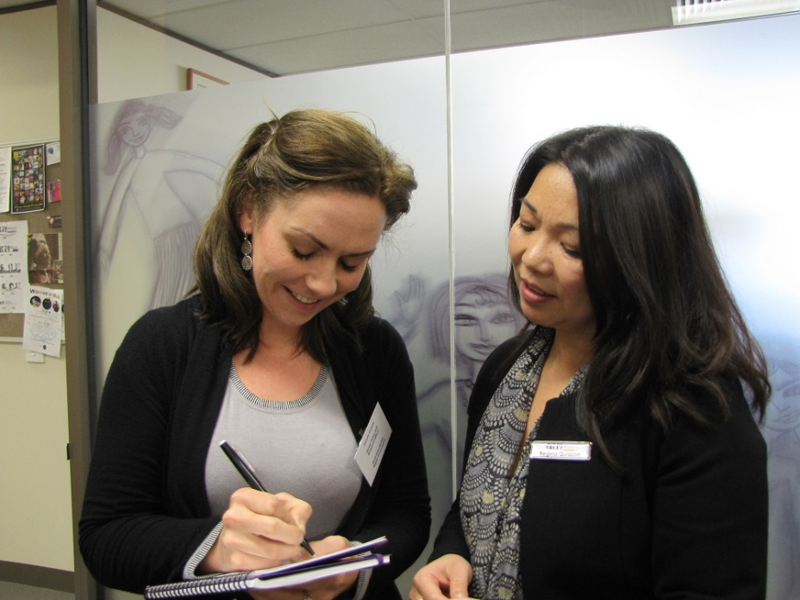
Thank you
Contact
Maria Hach maria@mcwh.com.au
Adele Murdolo adele@mcwh.com.au
Jasmin Chen jasmin@mcwh.com.au
Web: www.mcwh.com.au
Free Call: 1800 656 421

